Slide 1
Installing Reporting Services

Slide 2
Preparing for the Installation
The most important part of the Reporting Services installation is not what you do as you run the setup program, but what you do before you begin.
We will discuss about the knowledge you need and the steps you should take to prepare for installation.
With the proper plan in place, your Reporting Services installation should go smoothly and you can create reports in no time.

Slide 3
The Parts of the Whole
Reporting Services is not a single program that runs on a computer to produce reports.
Instead, it is a number of applications, utilities, and databases that work together to create a report management environment.
As you plan your Reporting Services installation, it is important that you understand a little bit about each piece of the puzzle and how all these pieces work together to create a complete system.
Figure in the next slide below shows all the parts that make up a complete Reporting Services installation.
Each part has a specific role to play in the development, management, and delivery of reports, or in the management of the Reporting Services environment itself.
All of these items can be installed as part of the SQL Server 2012 installation process.

Slide 4
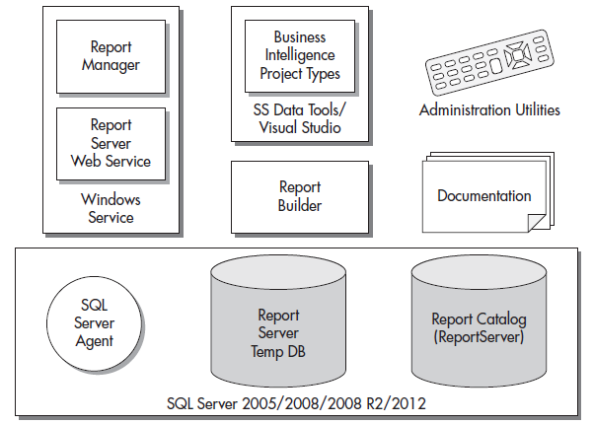

Slide 5
The Windows Service
The Reporting Services Windows service is the heart of Reporting Services and is, of course, installed as part of the Reporting Services installation.
This service is responsible for the two main interfaces with the report server.
First, it contains the application that implements the Report Manager website.
Second, it provides a web service interface for programmatic interaction with the report server.
The Report Server web service provides a programmatic interface for requesting reports. It also provides an interface for report server administration.
In addition to these two interfaces, the Reporting Services Windows service provides the engine responsible for report rendering.
This is true whether the report is requested through the Report Manager website, the report server web service, or subscription delivery.

Slide 6
Administration Utilities
The administration utilities are tools for managing the Reporting Services Windows service and for making changes to its configuration.
The main administration utility is the Reporting Services Configuration Manager.
This tool provides a convenient method for examining and modifying the configuration settings of a Reporting Services installation.
The administration utilities can be run on the computer that is hosting the Reporting Services Windows service to manage the configuration on that computer.
Most of the administrative utilities can also be used to manage a Reporting Services Windows service that is running on another computer.
This is called remote administration.

Slide 7
SQL Server 2005/2008/2008 R2/2012
One of the following versions of the SQL Server database engine is required to hold the database where Reporting Services stores its Report Catalog database:
SQL Server 2005
SQL Server 2008
SQL Server 2008 R2
SQL Server 2012
Reporting Services also uses the SQL Server Agent, which you will learn about shortly.
In addition, databases in SQL Server can be used as data sources for Reporting Services reports.

Slide 8
SQL Server Agent
SQL Server Agent is part of SQL Server and is created as part of the SQL Server installation process.
It is used by SQL Server to execute jobs scheduled to run at a certain time.
These jobs might back up a database or transfer information from one database to another.
Jobs may be scheduled to run once, or they may run on a regular basis, such as once a day or once a week.
Reporting Services also uses the SQL Server Agent to execute scheduled jobs. These jobs are used to run reports and distribute the results.
When a user creates a subscription,
Reporting Services creates a SQL Server Agent job to handle that subscription.

Slide 9
The Report Server and Report Server Temp DB Databases
During the Reporting Services installation process, two databases are created within SQL Server: the Report Server and Report Server Temp DB databases.
The Report Server database is used to store the Report Catalog.
The Report Server database also holds information about the virtual structure that contains these reports.
This includes such things as the folder structure displayed by the Report Manager and the security settings for each folder and report.
As the name implies, the Report Server Temp DB database is used as temporary storage for Reporting Services operations.
Information can be stored here to track the current users on the Report Manager website.
Short-term copies of some of the most recently executed reports are also stored here in what is known as the execution cache.

Slide 10
SQL Server Data Tools/Visual Studio/Report Builder
Reporting Services reports are created using SQL Server Data Tools, Visual Studio, or the Report Builder. All of these report development environments produce the same result.
There is no difference between a report created in SQL Server Data Tools, a Visual Studio development environment, or the Report Builder.
If you are going to use SQL Server Data Tools for creating reports, you need to install it as part of the Reporting Services installation process. Report Builder can be accessed through Report Manager.
It can also be downloaded from Microsoft and installed separately. If you plan to create reports using a Visual Studio development environment, you need to purchase and install it separately.

Slide 11
Documentation
The final piece of Reporting Services is the documentation. The bulk of this documentation is found in the SQL Server Books Online.
After Reporting Services is installed, you can view the SQL Server Books Online through your Start menu.
You’ll find it under All Programs | Microsoft SQL Server 2012 | Documentation & Community | SQL Server Documentation.
There is also a set of help screens for the Report Manager interface that can be accessed through the Report Manager user interface.

Slide 12
Editions of Reporting Services
Reporting Services can be licensed in following editions: Express Edition, Standard Edition, Business Intelligence Edition, Enterprise Edition and Developer Edition.
There is also an Evaluation Edition, which does not require a license, but it can only be used for a limited time.
Reporting Services is licensed as part of your SQL Server 2012 license.
In a production environment, the Reporting Services edition you are licensed to use is the same as the SQL Server 2012 edition you are licensed to use.
For example, if you have a Standard Edition of SQL Server 2012, you are only licensed for the Standard Edition of Reporting Services.

Slide 13
The Express Edition
All editions of Reporting Services provide a rich environment for report authoring, report management, and report delivery.
The Express Edition of SQL Server does not require a SQL Server database.
This edition does not include all of the business intelligence and high-availability features you find in the Standard, Business Intelligence, and Enterprise Editions.
When it comes to the reporting environment, it do not support e-mail and file share subscriptions, and report caching.
It also do not support SharePoint Integration mode. In addition, Reporting Services in these editions can only access 4GB of memory.

Slide 14
The Standard Edition
Standard Edition, as one might expect, provides the features needed by most “standard” SQL Server implementations. It includes the features excluded from the Express Edition.
Reporting Services in the Standard Edition can access as much memory as the operating system can make available.
Just a few of the more advanced features of Reporting Services are not included in the Standard Edition.
These advanced features are listed in the following section, “The Business Intelligence and Enterprise Editions.”

Slide 15
The The Business Intelligence and Enterprise Editions
The Business Intelligence and Enterprise Editions of Reporting Services includes the following advanced features.
Data-Driven Subscriptions - Send a report to a number of users from a predefined mailing list. Data-driven subscriptions are discussed in Module 11.
Scale-Out Deployment - Configure several Reporting Services Windows services running on multiple computers to point to a single SQL Server database engine hosting the Report Catalog. The scale-out deployment is discussed in the section “Types of Reporting Services Installations.”
The Enterprise Edition includes a number of features for handling large volumes of data and for implementing high availability that are not available in the Business Intelligence Edition.

Slide 16
The Developer Edition
The Developer Edition provides support for all of the features of the Enterprise Edition.
The Developer Edition does not, however, require that you have an Enterprise Edition license of SQL Server 2012.
The Developer Edition is only for development and testing. It cannot be used in a production environment.

Slide 17
Types of Reporting Services Installations
Now that we are familiar with the components that make up Reporting Services and the ways that Microsoft licenses it, we can give some thought to just what Reporting Services installation will look like.
The first decision we need to make is which of the components we want to install. Although we can choose to include or exclude items in any combination we like, in the end, only three combinations make sense: the full installation, the server installation, and the report author installation.
In addition to these are a couple of specialized installation types. These are the distributed installation and the scale-out installation.
These installations are for high-end, high-volume Reporting Services sites.
We will discuss these configurations briefly, so you become familiar with the variety of ways that Reporting Services can be configured.
Finally, there is one installation type that allows you to tightly couple Reporting Services with a SharePoint server.

Slide 18
The Full Installation
The full installation, as the name implies, is the “everything including the kitchen sink” installation. All of the items discussed previously are included in this installation. Nothing is left out.
The full installation is most likely to be used in a development environment.
This might be on a server used by a group of developers or on a power workstation used by a single developer.
In either case, we want to have all the bells and whistles available to us as we figure out how to best use Reporting Services to suit our business needs.

Slide 19
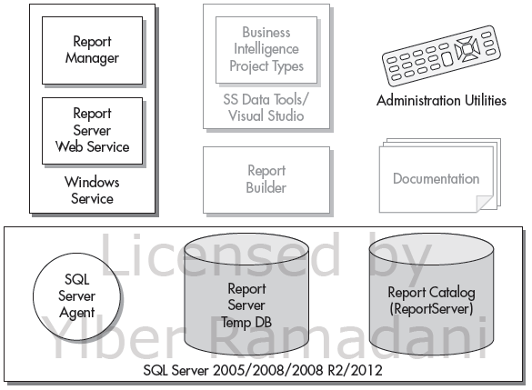
The Server Installation
The server installation is most likely used when we’re setting up Reporting Services on a production server. On a production server, we only want those items that are going to be used to deliver reports or to help us manage Reporting Services.
We don’t want to include anything that will take up space unnecessarily.
Figure on the right shows the items included in the server installation.
Reporting Services will need the SQL Server Agent, the Report Server database, and the Report Server Temp DB database for its operations.

Slide 20
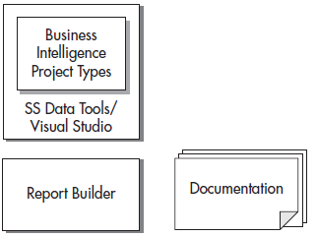
The Report Author Installation
The report author installation is for individuals who are creating Reporting Services reports but not doing heavy-duty development.
Report authors will not be creating full-blown applications that incorporate Reporting Services as part of a larger business system. The items included in the report author installation are shown here.
Report authors need the capability to create and preview reports. This capability is found in SQL Server Data Tools, Visual Studio, or the Report Builder.
Report authors may also want access to the Reporting Services Books Online to look up information as they create reports.

Slide 21
The Distributed Installation
In a distributed installation, the Reporting Services items discussed are not installed on a single computer. Instead, they are split between two computers that work together to create a complete Reporting Services system.
One computer runs SQL Server 2005 or SQL Server 2008 and hosts the Report Catalog databases.
This is the database server. The other computer runs the Reporting Services Windows service. This is the report server.
The distributed installation has advantages when it comes to scalability. Because the workload of the server applications - SQL Server and the Reporting Services Windows service - is divided between two servers, it can serve reports to a larger number of simultaneous users.
The disadvantage of this type of installation is that it is more complex to install and administer. However, if you need a high-volume solution, it is certainly worth the effort to obtain one that will provide satisfactory response times under a heavy workload.

Slide 22
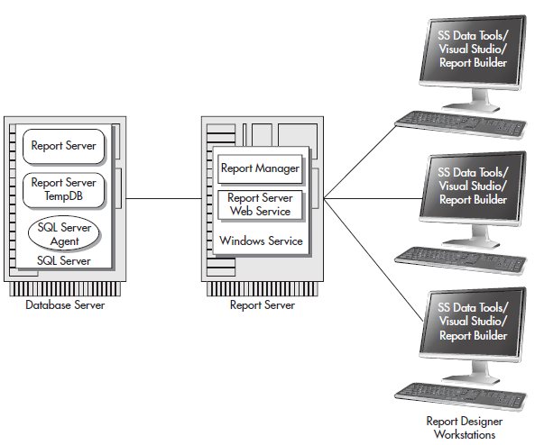
The Distributed Installation

Slide 23
The Scale-Out Installation
The scale-out installation is a specialized form of the distributed installation, as shown in the next slide. In a scale-out installation, a single database server interacts with several report servers.
Each of the report servers uses the same Report Catalog databases for its information.
By using additional report servers, we can handle even more simultaneous users with the scale-out installation than we could with the distributed installation.
When report designers create reports, they can deploy them to any of the report servers. No matter which server is used, the reports will end up in the single Report Server database.
Once the reports are in the Report Server database, they can be delivered by any of the report servers.
Because all of the information about the Report Manager is stored in the Report Server database, any changes to the Report Manager configuration made on one server will take effect on all the servers.
The scale-out installation may take additional effort to get up and running, but once it is ready to go, it provides an efficient means of serving a large number of users.

Slide 24
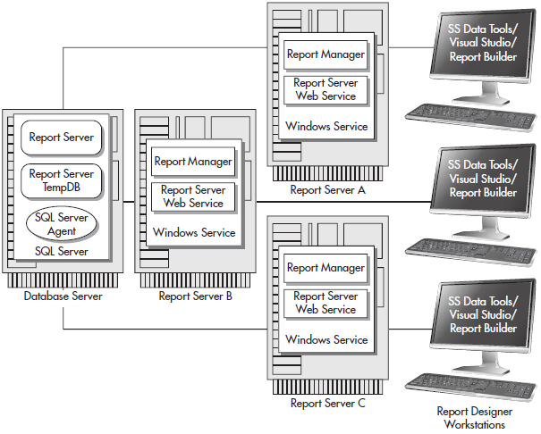
The Scale-Out Installation
As with the distributed installation, the scale-out installation provides a way to handle a large number of simultaneous requests for reports.
Even though the scale-out installation uses a number of servers to deliver reports, it allows the Report Manager interface to be administered without duplication of effort.

Slide 25
SharePoint Integrated Mode Installation
For all of the types of Reporting Services installations previously mentioned, the Report Manager user interface, provided by Reporting Services itself, facilitates the interaction of users with the reports.
It is also possible to install Reporting Services so that a SharePoint server provides the interface for interaction with the reports. This is known as Reporting Services SharePoint Integrated mode.
When operating in SharePoint Integrated mode, reports are stored as documents on a SharePoint Server. This allows you to manage reports in the same way you would manage Word documents and Excel spreadsheets.
Many of the SharePoint features available for document management, such as searching and version control, can be applied to Reporting Services reports.
In addition, existing SharePoint security can be applied to reports rather than requiring the creation of a second security structure in Report Manager.

Slide 26
Installation Requirements - Hardware Requirements
With Reporting Services, we are dealing with a server application that will be handling requests from a number of users at the same time. In most installations, the Reporting Services Windows service will be sharing processor time and computer memory with SQL Server 2008. We need to have enough server power so both of these systems can happily coexist.
Processor - Microsoft’s stated minimum processor is a 1 gigahertz (GHz) Pentium III compatible processor. You should install Reporting Services on this type of computer only if you are a patient person. A more realistic low end is probably a Pentium Dual-core at 1.6 GHz. This is true even for the report author installation. SQL Server Data Tools and Visual Studio demand a fair amount of horsepower to keep them from being sluggish.
Computer Memory - Microsoft’s minimum requirement for computer memory is 512 megabytes (MB). This is, indeed, a bare minimum. If you are running the Reporting Services Windows service on the same server with SQL Server, that minimum should probably go up to 2GB. Again, these are the absolute minimums - 4GB or more is a much better place to start.
Disk Space - A server installation of Reporting Services requires a minimum of 120MB of disk space. This does not include the space required for SQL Server 2012. Consult the Microsoft website for information on the disk space requirements for these items. A report author installation requires a minimum of 1.1GB of disk space. Plan on using an additional 145MB if you are downloading and installing the sample reports.

Slide 27
Installation Requirements - Software Requirements
SQL Server 2012 Reporting Services will run on the following operating systems:
Windows 7 (32-bit or 64-bit)
Vista (32-bit or 64-bit)
Windows Server 2008 SP2 (32-bit or 64-bit)
Windows Server 2008 R2
The following software must be installed and running properly on your computer before you can complete a server installation:
Microsoft Windows Installer 4.5 or later
Windows PowerShell 2.0
Microsoft .NET Framework version 4.0
Microsoft .NET Framework 4.0 will be installed as the first step in the SQL Server 2012 installation process if it is not already present on the target computer.

Slide 28
Distributed Installation and Scale-Out Installation Considerations
If you create a distributed installation, the report server and the database server must be in the same domain or in domains that have a trust relationship.
If you create a scale-out installation, all the report servers and the database server must be in the same domain or in domains that have a trust relationship.

Slide 29
SharePoint Integrated Mode Considerations
For a SharePoint Integrated mode installation, you must have an instance of SharePoint running on the server where you will be installing Reporting Services. The following versions of SharePoint are supported:
SharePoint Foundation 2010
SharePoint Server 2010
Windows SharePoint Services 3.0
Office SharePoint Server 2007
Note that SharePoint 2010 requires Windows Server 2008 SP2 or Windows Server 2008 R2, and is only available as a 64-bit install.

Slide 30
Database Server Considerations
The following are a couple of things to keep in mind as you are determining which server will host the Reporting Services databases:
The Report Server and Report Server Temp DB databases must be hosted by SQL Server 2005, SQL Server 2008, SQL Server 2008 R2, or SQL Server 2012. They cannot be hosted by an earlier version of SQL Server.
If you do not want to use the default name for the Reporting Services database (ReportServer), you can specify a different name. The database name you specify must be 117 characters or fewer.

Slide 31
E-mail (SMTP) Server
If you are going to allow users to subscribe to reports and have them e-mailed, you need to specify the address of a Simple Mail Transfer Protocol (SMTP) server using the Reporting Services Configuration Manager.
SMTP is the standard for exchanging e-mail across the Internet. You need to specify the address of an e-mail server that will accept e-mail messages from the report server and send them to the appropriate recipients.
In many cases, the address of your e-mail server is the same as the portion of your e-mail address that comes after the @ sign, prefaced by www.
For example, if your e-mail address is MyEmail@Galactic.com, your e-mail server’s address is probably either www.Galactic.com or smtp.Galactic.com.
Be sure to verify the address of your e-mail server with your e-mail administrator. Also, make sure this e-mail server supports the SMTP protocol and that it will accept and forward mail originating from other servers on your network.

Slide 32
Encrypting Reporting Services Information
One of the options you may specify in the Reporting Services Configuration Manager is a requirement to use a Secure Sockets Layer (SSL) connection when accessing the Report Manager website and the Report Server web service.
When an SSL connection is used, all of the data transmitted across the network is encrypted, so it cannot be intercepted and read by anyone else. This is important if your reports contain sensitive personal or financial information.
To use SSL on a server, the server must have a server certificate. Server certificates are purchased from a certificate authority and installed on your server. You can find information on certificate authorities on the Internet.
Each server certificate is associated with a specific Uniform Resource Locator (URL). To use SSL with the Report Manager website and the Report Server web service, your server certificate must be associated with the URL that corresponds to the default website on the server.
If you plan to require an SSL connection, you should obtain and install the appropriate server certificate prior to installing Reporting Services.
When you require the use of an SSL connection to access the Report Manager website and the Report Server web service, your users must specify a slightly different URL to access these locations.

Slide 33
Login Accounts
The login account you are logged in as when you run the setup program must have administrative rights on the computer where the installation is being done.
If you are doing a distributed or scale-out installation, the login account must have administrative rights on the computer that will be the report server and have SQL Server administrator rights on the database server.
The login account you are logged in as must also have system administration rights in the SQL Server installation that will contain the Report Catalog.
The setup program uses this login to access SQL Server and create the items necessary for the Report Catalog. You will be asked to specify two other login accounts during the Reporting Services installation and in the Reporting Services Configuration Manager.
Make your choices ahead of time and track down any passwords you may need before you begin the installation process.

Slide 34
The Reporting Services Windows Service Account
During the installation process, you will be asked to specify the login account used by the Reporting Services Windows service.
If you are installing the SQL Server database engine or other SQL components as part of the same installation, you will be asked for login accounts for each of the necessary Windows services at the same time.
You can choose from the following types of accounts:
The built-in LocalSystem account - The LocalSystem account has access to almost all resources on the local computer and may or may not have access to resources on other computers in the network. You do not need to supply a password if you use this account.
The built-in NetworkService account - This account exists on Windows server operating systems for running services. The difference between this account and the local service account is that this account has rights on the network and can access other servers on the network. You do not need to supply a password if you use this account.
The built-in LocalService account - This account exists on Windows serveroperating systems for running services. The difference between this account and the NetworkService account is that this account does not have rights on the network and cannot access other servers on the network. You do not need to supply a password if you use this account.
A domain user account This is a regular user account that exists in the domain in which this server resides. You will need to know both the login name and the password.
Microsoft recommends the network service account be used as the login account for the Report Server service. Using the network service account ensures the Report Server service has all the rights it needs on the local server.

Slide 35
The Report Server Database Credentials
In the Reporting Services Configuration Manager, you can specify the report server database credentials. These credentials are used by the Reporting Services Windows service to log in to SQL Server and to access the Report Server database, the Report Server Temp DB database, and the SQL Server Agent.
As noted earlier, this login account is used after the installation is complete. It is not used to access SQL Server during the installation process.
You have two options:
The login account used by the Reporting Services Windows service
A SQL Server login
You need to work with the database administrator of your SQL Server to determine which of these options to use.

Slide 36
Running the SQL Server Installation Program
When you run the SQL Server installation program, you need to run it under a login that is a member of the local system administrators group.
In addition, your login needs to have administrator permissions in SQL Server so you can perform the following tasks:
Create SQL logins
Create SQL roles
Create databases
Assign roles to logins

Slide 37
The SQL Server 2012 Installation
If you are doing a full, server, distributed, or scale-out installation of Reporting Services, the setup program must be run on the computer that will serve as the report server.
This is the computer that will be running the Reporting Services Windows service and hosting Report Manager and the Report Server web service.
If you are doing a report author installation, the setup program must be run on the computer you will be using for report authoring.
If you are doing a distributed or scale-out installation, you do not need to run the Reporting Services setup program on the database server.
You will, need to install SQL Server 2005, SQL Server 2008, SQL Server 2008 R2, or SQL Server 2012 on the database server prior to doing the Reporting Services installation, but you do not need to run the Reporting Services portion of the setup program on that computer.

Slide 38
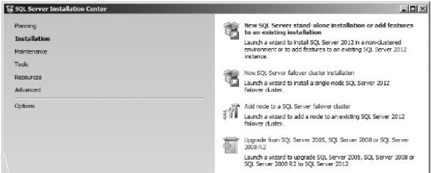
The SQL Server 2008 Installation
Begin the installation by inserting the SQL Server 2012 installation CD into the CD or DVD drive.
In most cases, the autorun process should take you to the Start screen.
When you are ready to begin the actual installation, select New SQL Server stand-alone installation or add features to an existing installation from the Installation page as shown in Figure below.

Slide 39
The Feature Selection Page
On the Feature Selection page of the Installation Wizard, you can determine which components of SQL Server to install.
The following sections show which items to select on the Feature Selection page for each type of installation.
Reporting Services Full Installation - On the Feature Selection page, select the following for a Reporting Services full installation:
Database Engine Services, if you do not already have an appropriate version SQL Server database engine available to host the Report Catalog
Reporting Services - Native
SQL Server Data Tools
Client Tools Connectivity
Documentation Components
Management Tools - Basic and Management Tools - Complete

Slide 40
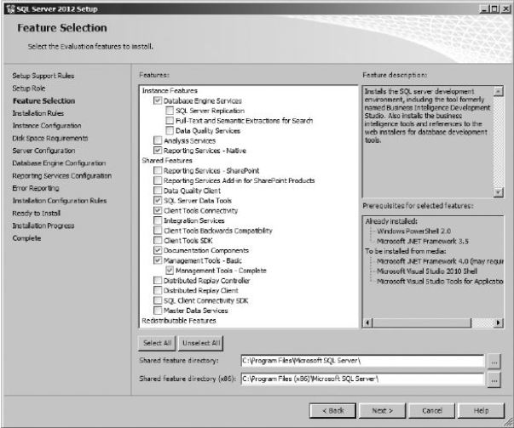
The Feature Selection Page
The Feature Selection page should appear as shown in figure below. Click Next to continue with the SQL Server Installation Wizard.

Slide 41
The Feature Selection Page
Reporting Services Server Installation - On the Feature Selection page, select the following for a Reporting Services server installation:
Database Engine Services, if you do not already have an appropriate version SQL Server database engine available to host the Report Catalog
Reporting Services - Native
Client Tools Connectivity
Management Tools - Basic and Management Tools – Complete
The Feature Selection page should appear as shown in figure on next slide. Click Next to continue with the SQL Server Installation Wizard.

Slide 42
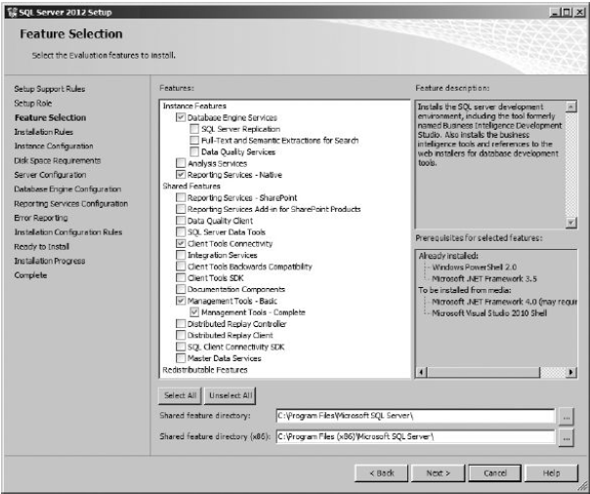
The Feature Selection Page
Reporting Services Server Installation

Slide 43
The Feature Selection Page
Reporting Services Report Author Installation - On the Feature Selection page, select the following for a Reporting Services report author installation:
SQL Server Data Tools
Client Tools Connectivity
Documentation Components
Management Tools - Basic and Management Tools - Complete
The Feature Selection page should appear as shown in figure on next slide. Click Next to continue with the SQL Server Installation Wizard.

Slide 44
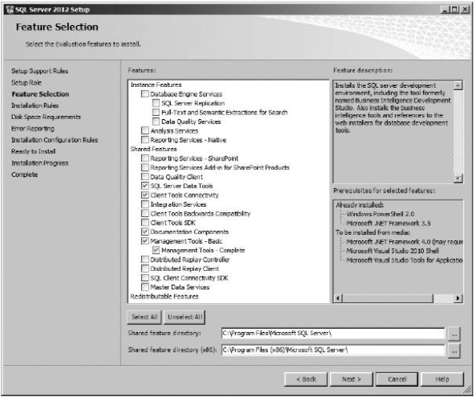
The Feature Selection Page
Reporting Services Report Author Installation

Slide 45
The Feature Selection Page
Reporting Services Distributed Installation and Scale-out Installation – Before completing the Reporting Services portion of a distributed or scale-out installation, you must have either SQL Server 2005, SQL Server 2008, SQL Server 2008 R2, or SQL Server 2012 running on the computer that will serve as the database server.
Either the Business Intelligence Edition or theEnterprise Edition of Reporting Services is required for a scale-out installation.
On the Feature Selection page, select the following for a Reporting Services distributed installation or a scale-out installation:
Reporting Services - Native
Client Tools Connectivity
Management Tools - Basic and Management Tools - Complete
The Feature Selection page should appear as shown in figure on the next slide. Click Next to continue with the SQL Server Installation Wizard.

Slide 46
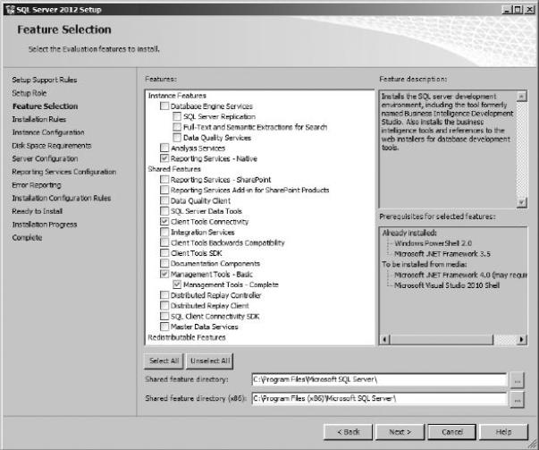
The Feature Selection Page
Reporting Services Distributed Installation and Scale-out Installation

Slide 47
The Feature Selection Page
Reporting Services SharePoint Integrated Mode Installation – On the Feature Selection page, select the following for a Reporting Services SharePoint Integrated mode installation:
Reporting Services - SharePoint
Reporting Services Add-in for SharePoint Products
The Feature Selection page should appear as shown in figure on the next slide. Click Next to continue with the SQL Server Installation Wizard.

Slide 48
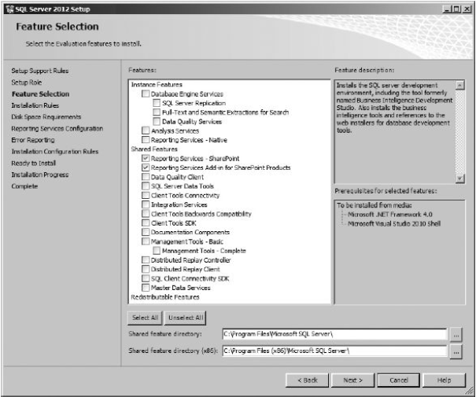
The Feature Selection Page
Reporting Services Distributed Installation and Scale-out Installation

Slide 49
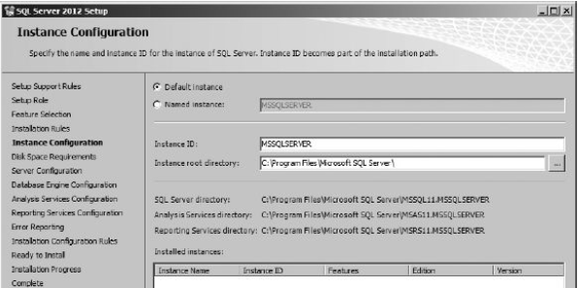
Instance Configuration Page
The Instance Configuration page, shown in figure below, enables you to choose the name assigned to this instance of the components you are installing, including Reporting Services.
The default instance will use Reports as the name of the Report Manager website and ReportServer as the name of the Reporting Services web service.
If you specify an instance name, by default an underscore (_) followed by the instance name is appended to the end of the website and web service name (Reports and ReportServer respectively).

Slide 50
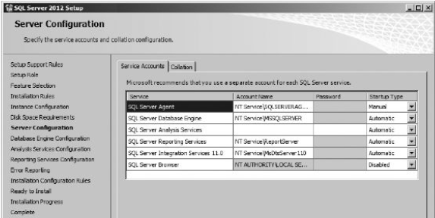
Server Configuration Page
The Server Configuration page is shown in figure below. This page enables you to specify the Windows credentials the Reporting Services Windows service is to run under.
The content of this screen will vary, depending on the SQL Server 2012 components you chose to install.
This page also enables you to select the startup type of each of the services being installed. If SQL Server was included as part of this install, SQL Server Agent should be changed to the Automatic startup type.

Slide 51
The Reporting Services Configuration Page
After leaving the Server Configuration page, you may encounter several pages that deal with the setup of the SQL Server database engine and other SQL Server components, depending on the items selected on the Feature Selection page.
After making appropriate choices for your SQL Server installation click Next to move from one page to the next.
Eventually, you will come to the Reporting Services Configuration page.
If SQL Server was selected on the Feature Selection page and you are installing the default instance, this page provides you with two choices for configuring your Reporting Services installation:
Install and configure
Install only

Slide 52
The Reporting Services Configuration Page
If the Install only option is chosen, your new Reporting Services installation will need to be configured using the Reporting Services Configuration Manager utility program.
This may seem like a rather limiting set of choices, sort of an all-or-nothing proposition, but it is not.
For the majority of Reporting Services installations, the native mode default configuration will do just fine. Only rarely, for distributed or scale-out installations, or for non-default instances, do you need to change the default configuration settings.
The default configuration settings are:
Web service name is ReportServer.
Report Manager website is Reports.
The Report Catalog is hosted by the default instance of SQL Server 2012 being created by this installation process.
The login account used by the Reporting Services Windows service is used as the credentials for accessing the report server database (Report Catalog).

Slide 53
Completing the SQL Server Installation Wizard
After a couple of summary screens, the SQL Server Installation Wizard has all the information it requires to install the components of SQL Server you requested.
Remember, if you chose the Install, but do not configure the report server option, you will need to run the Reporting Services Configuration Manager to complete the final configuration of Reporting Services.
Even if you did use the Reporting Services Native mode default configuration, you should run the Reporting Services Configuration Manager to complete one important task. You should always create a backup of the Reporting Services encryption key as the final step of a Reporting Services installation.

Slide 54
The Reporting Services Configuration Manager
If you want to deviate from the Native mode default configuration, you must use another tool to make these non-default configuration settings. That tool is the Reporting Services Configuration Manager.
The Reporting Services Configuration Manager is found on the Start menu under All Programs | Microsoft SQL Server 2012 | Configuration Tools | Reporting Services Configuration Manager.
When this utility starts up, it asks for the name of a server to connect to.
Once you enter a server name and click Find, the program finds all instances of Reporting Services 2012 running on that server and displays them in the Report Server Instance drop-down box.

Slide 55
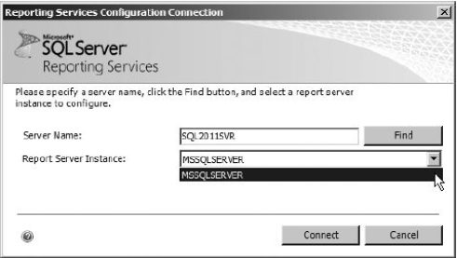
The Reporting Services Configuration Manager
You need to select an instance and click Connect to enter the utility program with the configuration information for that Reporting Services instance loaded.

Slide 56
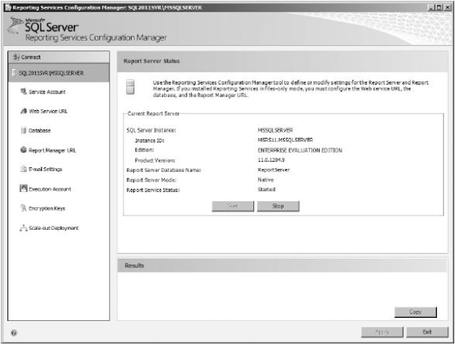
The Reporting Services Configuration Manager - Server Status Page
The Report Server Status page displays status information about the Report Server instance you selected, as shown in figure below.
There is no configuration information to change on this page. This page does provide buttons to start or stop this instance of Reporting Services.

Slide 57
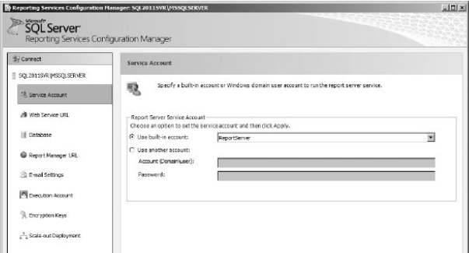
The Reporting Services Configuration Manager - Service Account Page
The Service Account page enables you to view and change the credentials used to run the Reporting Services Windows service. This is shown in figure below.
These are the same credentials you set on the Server Configuration page of the SQL Server 2012 Installation Wizard.

Slide 58
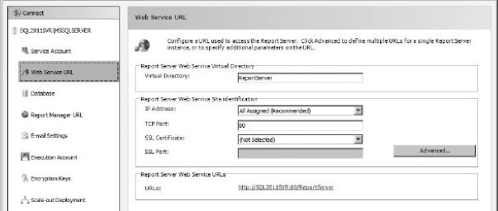
The Reporting Services Configuration Manager - Web Service URL Page
The Web Service URL page enables you to view and change the URL used by the Reporting Services web service. This page is shown in figure below.
If this is the default instance of Reporting Services on the server, the default name for this virtual directory is ReportServer.
The Web Service URL page also enables you to select the Internet Protocol (IP) address and Transmission Control Protocol (TCP) port used by the Report Server web service.

Slide 59
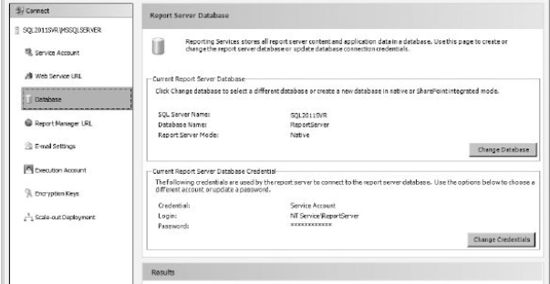
The Reporting Services Configuration Manager - Report Server Database Page
The Report Server Database page, shown in figure below, enables you to select the set of databases that will serve as the Report Catalog.
You can select the database server name, the name of the database on that server, and the credentials used to connect to that server.
If you are performing a distributed or scale-out installation, this is where you will select the remote database server for hosting the Report Catalog.

Slide 60
The Reporting Services Configuration Manager - Report Server Database Page
Click the Change Database button to change the database server or database to be used by the report server. You can create a new report server database or choose an existing report server database.
In either case, you will need to complete the following steps:
Specify the database server and the credentials to be used to complete the current operation. These credentials are not necessarily the same as those that will be used by the Reporting Services Windows service to connect to the database.
Provide the name of the database.
Specify the credentials used by the Reporting Services Windows service to connect to the database.
Click the Change Credentials button to change only the credentials used by the Reporting Services Windows service to connect to the database.
When you click the Apply button, the following tasks are performed:
Grant access rights to Report Server accounts This task will set the appropriate rights in the databases for the credentials specified to be used by the Reporting Services Windows service.
Set the connection information This task will set this Reporting Services instance to use the specified Report Catalog.

Slide 61
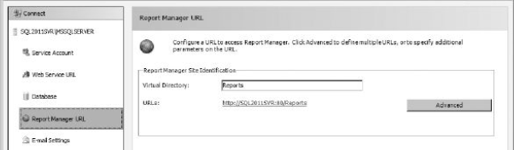
The Reporting Services Configuration Manager - Report Manager URL Page
The Report Manager URL page enables you to view and change the name of the virtual directory used by the Report Manager website. This page is shown in figure below.
As mentioned previously, if this is the default instance of Reporting Services on the server, the default name for this virtual directory is Reports.
Clicking the URL shown on this page will open Internet Explorer and take you to the Report Manager website.

Slide 62
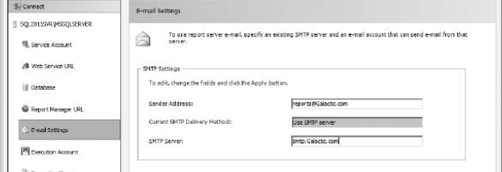
The Reporting Services Configuration Manager - E-mail Settings Page
The E-mail Settings page, shown in figure below, enables you to identify an SMTP server that can be used by Reporting Services.
If an SMTP server is not specified, the e-mail delivery option will be unavailable when creating report subscriptions.
Enter the name of an SMTP server that will accept mail from Reporting Services. You can also enter an e-mail address for Sender Address. This e-mail address will appear in the From line of any report subscriptions e-mailed from Reporting Services.

Slide 63
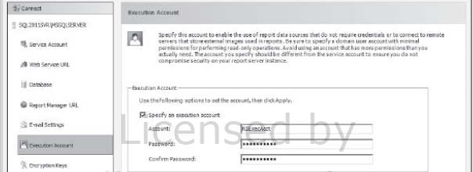
The Reporting Services Configuration Manager - Execution Account Page
The Execution Account page, shown in figure below, enables you to specify a set of login credentials to be used by Reporting Services when it needs to access a file or other resource.
For example, suppose you have a report that uses an Access database as its data source and that Access database does not require logon credentials.
When it is time for the report to query the data from the Access database, the Execution Account credentials are used to gain rights to the Access MDB file.

Slide 64
The Reporting Services Configuration Manager - Encryption Keys Page
As you have seen, Reporting Services uses various sets of credentials for its operation.
Whenever a login account and a password are specified, these credentials are stored as encrypted text. To encrypt and, more importantly, to decrypt these credentials, Reporting Services needs to use an encryption key. This encryption key is created as part of the Reporting Services installation.
If this encryption key ever becomes corrupt, none of these encrypted credentials can be decrypted. The credentials become useless, and Reporting Services becomes inoperable.
To remedy this situation, you need to have a backup of the encryption key, which can be restored over the top of the corrupt key. This is the purpose of the Encryption Keys page, shown in figure below.

Slide 65
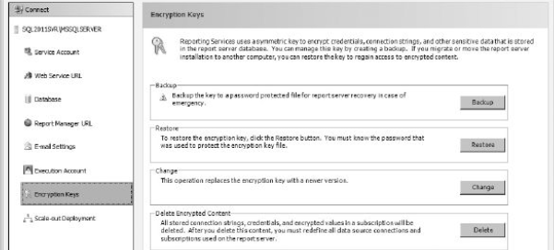
The Reporting Services Configuration Manager - Encryption Keys Page
Use the Backup button to create a backup copy of the encryption key.
Use the Restore button to restore a previously created encryption-key backup.
Use the Change button to create a new encryption key for Reporting Services. This should be done if your current encryption key becomes compromised.
If your Reporting Services encryption key does become corrupt and you do not have a current backup, use the Delete button.

Slide 66
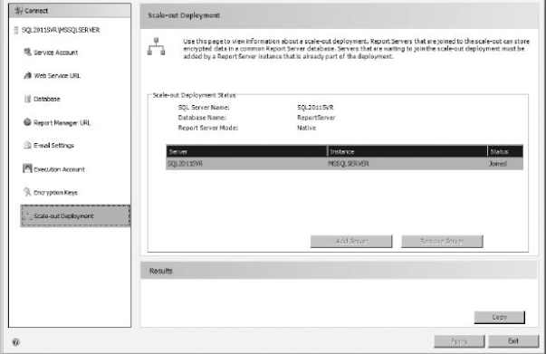
The Reporting Services Configuration Manager - Scale-out Deployment Page
The Scale-out Deployment page, shown in figure below, is used to add servers to a scale-out installation of Reporting Services.
Each server added to the scale-out list uses the same encryption key. In this way, encrypted data stored in the common Report Catalog can be decrypted by any report server in the scale-out installation.

Slide 67
Common Installation Issues
Administrative Rights - One of the most frequent problems with the Reporting Services setup is not using login accounts that have the appropriate rights. If you discover you received a setup error because one of the login accounts you used was not adequate to the task, try changing that account using the Reporting Services Configuration Manager.
Server Components Not Shown on the Feature Selection Screen - If you are performing an installation that requires the server components, but they are not present on the Feature Selection screen, this is probably an indication that you are not up-to-date on your Windows service packs.

Slide 68
Common Installation Issues
Installation Error 2755 - You may receive Error 2755 if you are installing Reporting Services using a Terminal Server session. This will occur if you are using a mapped drive to access the setup files. The Windows Installer service that performs the setup operation is running in a different Windows session, so it may not have the same drive mappings. The error occurs because certain files needed by the installer cannot be found.
Reporting Services and IIS on the Same Server - If you are installing the report server on a computer that is already running IIS, care must be taken to ensure that these two services are not using the same TCP/IP port. Both IIS and the Report Server will default to using port 80 for HTTP requests and port 443 for HTTPS requests. If this occurs, IIS and the Report Server will compete to handle traffic on these ports, resulting in neither service working correctly.

Slide 69
Common Installation Issues
The Repair Utility and Installation Log File - If your installation does not complete successfully, you can try the Repair utility on the Maintenance page of the SQL Server Installation Center. If none of these suggestions solve your installation issues, you may want to consult the installation log files for more information.
The default location for the log files is
C:\Program Files\Microsoft SQL Server\110\Setup Bootstrap\Log
The log files will be in a folder named for the date and time of the installation.

